Slide 1
Direct Method of Interpolation
by
Dr. Md. Rajibul Islam
CSE, UAP

Slide 2
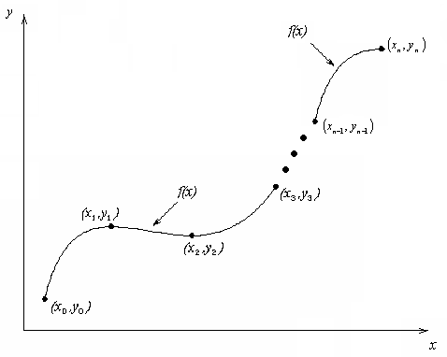
What is Interpolation ?
Given (x₀,y₀), (x₁,y₁), …… (x_{n},y_{n}), find the value of ‘y’ at a value of ‘x’ that is not given.
Figure 1 Interpolation of discrete.

Slide 3

Interpolants
Polynomials are the most common choice of interpolants because they are easy to:
Evaluate
Differentiate, and
Integrate

Slide 4
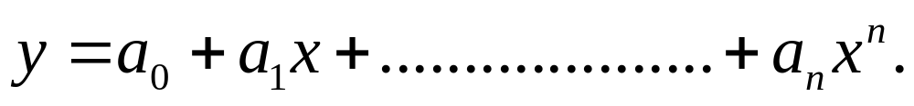
Direct Method
Given ‘n+1’ data points (x₀,y₀), (x₁,y₁),………….. (x_{n},y_{n}),
pass a polynomial of order ‘n’ through the data as given
below:
where a₀, a₁,………………. a_{n} are real constants.
Set up ‘n+1’ equations to find ‘n+1’ constants.
To find the value ‘y’ at a given value of ‘x’, simply substitute the value of ‘x’ in the above polynomial.

Slide 5

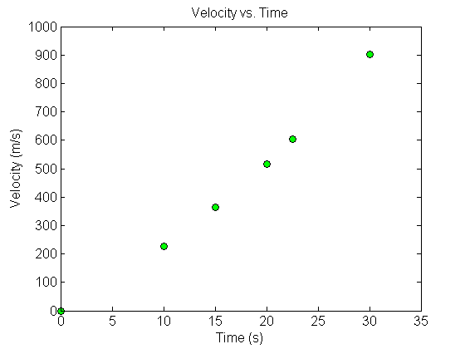


Example 1
The upward velocity of a rocket is given as a function of time in Table 1.
Find the velocity at t=16 seconds using the direct method for linear interpolation.
Table 1 Velocity as a function of time.
0 | 0
10 | 227.04
15 | 362.78
20 | 517.35
22.5 | 602.97
30 | 901.67
Figure 2 Velocity vs. time data for the rocket example

Slide 6

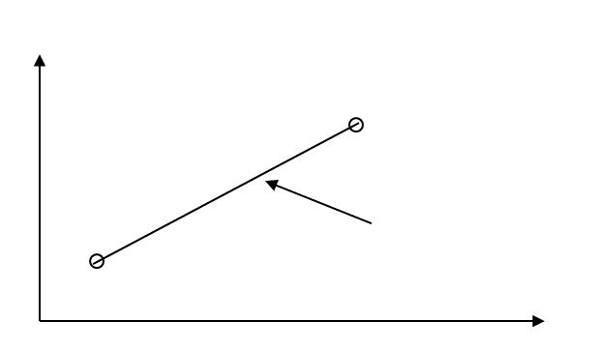








Linear Interpolation
Solving the above two equations gives,
Figure 3 Linear interpolation.
Hence

Slide 7
Example 2
The upward velocity of a rocket is given as a function of time in Table 2.
Find the velocity at t=16 seconds using the direct method for quadratic interpolation.
Table 2 Velocity as a function of time.
0 | 0
10 | 227.04
15 | 362.78
20 | 517.35
22.5 | 602.97
30 | 901.67
Figure 5 Velocity vs. time data for the rocket example

Slide 8
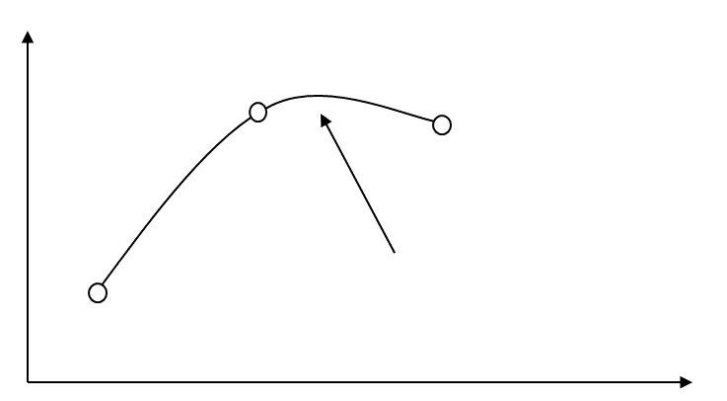






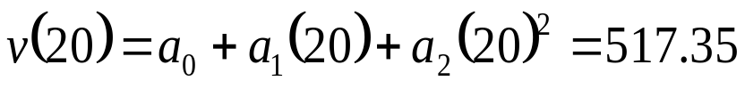


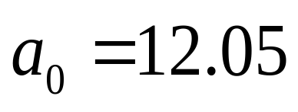
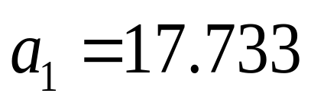
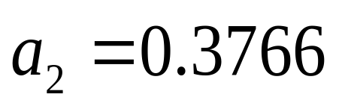
Quadratic Interpolation
Quadratic Interpolation
Figure 6 Quadratic interpolation.
Solving the above three equations gives

Slide 9
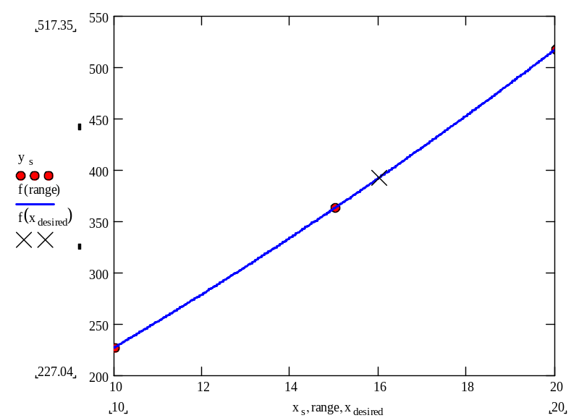


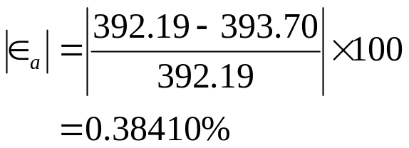
Quadratic Interpolation (cont.)
The absolute relative approximate error obtained between the results from the first and second order polynomial is

Slide 10
Example 3
The upward velocity of a rocket is given as a function of time in Table 3.
Find the velocity at t=16 seconds using the direct method for cubic interpolation.
Table 3 Velocity as a function of time.
0 | 0
10 | 227.04
15 | 362.78
20 | 517.35
22.5 | 602.97
30 | 901.67
Figure 6 Velocity vs. time data for the rocket example

Slide 11










Cubic Interpolation
Figure 7 Cubic interpolation.

Slide 12
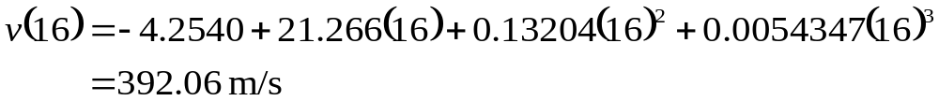
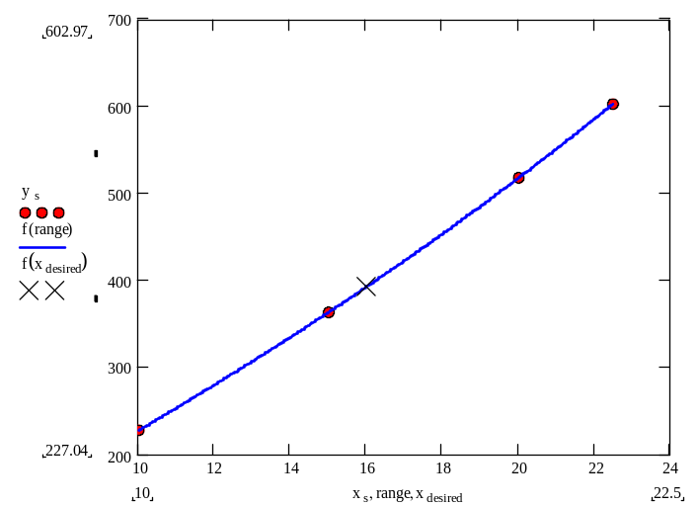

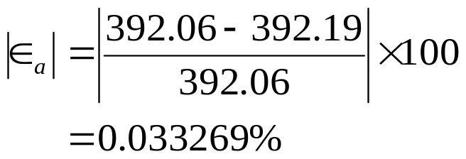
Cubic Interpolation (contd)
The absolute percentage relative approximate error between second and third order polynomial is

Slide 13
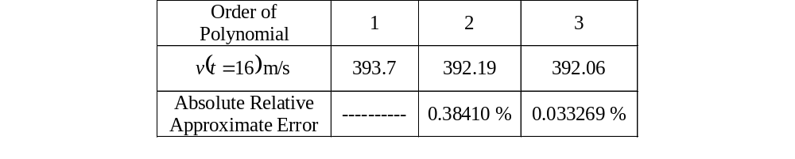
Comparison Table
Table 4 Comparison of different orders of the polynomial.
t(s) | v (m/s)
0 | 0
10 | 227.04
15 | 362.78
20 | 517.35
22.5 | 602.97
30 | 901.67

Slide 14
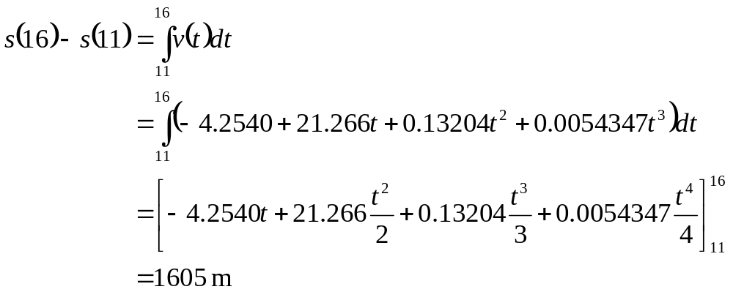
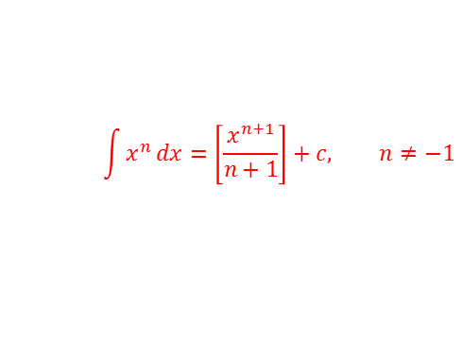
Distance from Velocity Profile
Find the distance covered by the rocket from t=11s to t=16s ?
From our integral knowledge, we know this!

Slide 15
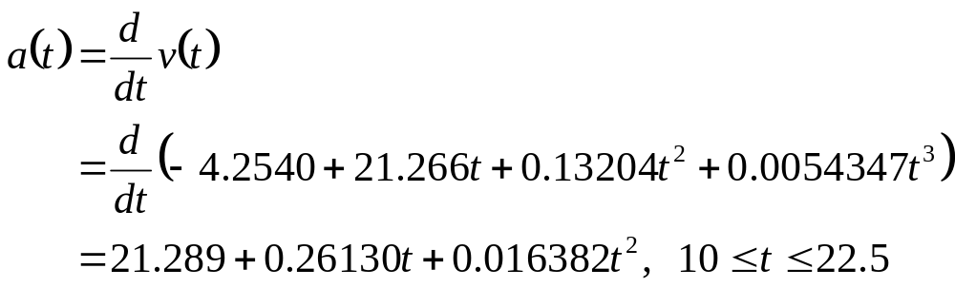
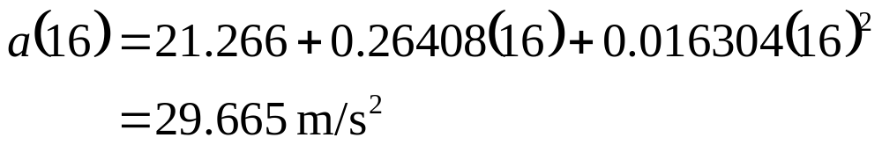
Acceleration from Velocity Profile
Find the acceleration of the rocket at t=16s given that

Slide 16
THE END

